Slide 1



COMPARATIVE ANALYSIS OF DATABASE EFFICIENCIES IN SUPPLY CHAIN MANAGEMENT
12/05/2023
TEAM: 07

Slide 2




OUR TEAM
SAI KRISHNA PAILA
ANERI PATEL
SMIT PANCHOLI

Slide 3

OUTLINE
01
INTRODUCTION
02
DATA OVERVIEW
03
DATABASE TECHNOLOGIES USED
04
METHODOLOGY
05
QUERY PERFORMANCE ANALYSIS
06
RESULTS
07
CONCLUSION

Slide 4

INTRODUCTION
Supply chain management is Managing the journey of goods from production to consumer, integrating production, inventory, and transportation.
This project focuses on assessing MySQL, MongoDB, and Neo4j for handling intricate supply chain management data.
The dataset used comprises comprehensive information about orders, customer profiles, product details, sales records, and delivery statuses.
The analysis aims to determine which database system offers the most optimal performance for supply chain management scenarios, with a particular focus on time efficiency and data processing capabilities.

Slide 5



DATA OVERVIEW
The project utilizes a comprehensive dataset provided by DataCo, seamlessly imported into MySQL, MongoDB, and Neo4j databases to leverage distinct data processing capabilities and evaluate comparative performance metrics."
DATA
ROWS:
79 K
COLUMNS:
51
DATA TYPE:
STRUCTURED

Slide 6




DATABASE TECHNOLOGIES USED
MySQL is an open-source relational database management system. It uses structured query language (SQL) for accessing and managing data, and is known for its reliability, robustness, and strong data integrity features.
MongoDB is a leading NoSQL database that stores data in flexible, JSON-like documents. This means fields can vary from document to document and data structure can be changed over time.
Neo4j is a graph database management system, renowned for its ability to efficiently store and query connected data. It uses graph structures with nodes, edges, and properties to represent and store data.
MYSQL
MONGODB
NEO4J

Slide 7

METHODOLOGY
Data Loading into Databases
MYSQL
Utilized Python's mysql-connector and SQLAlchemy for SQL database connections. Data reading and processing were managed using the pandas library.
The SQLAlchemy toolkit facilitated loading data into the SQL database. Additionally, mysql-connector served as the primary connector to the MySQL database.
MONGODB
Data was imported directly into MongoDB using MongoDB Compass
.
For executing queries and database interaction within Python, the MongoClient from the pymongo library was employed, establishing a seamless connection with the MongoDB database.

Slide 8

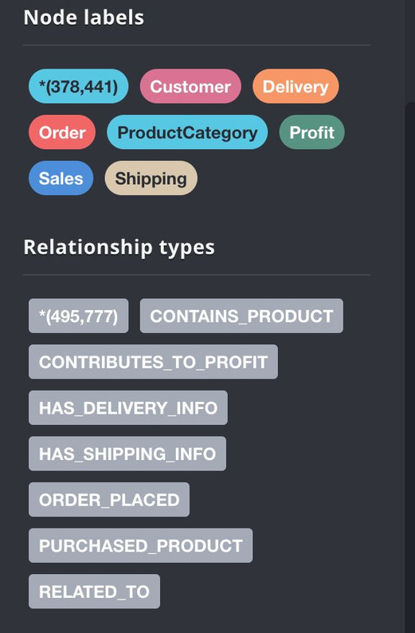
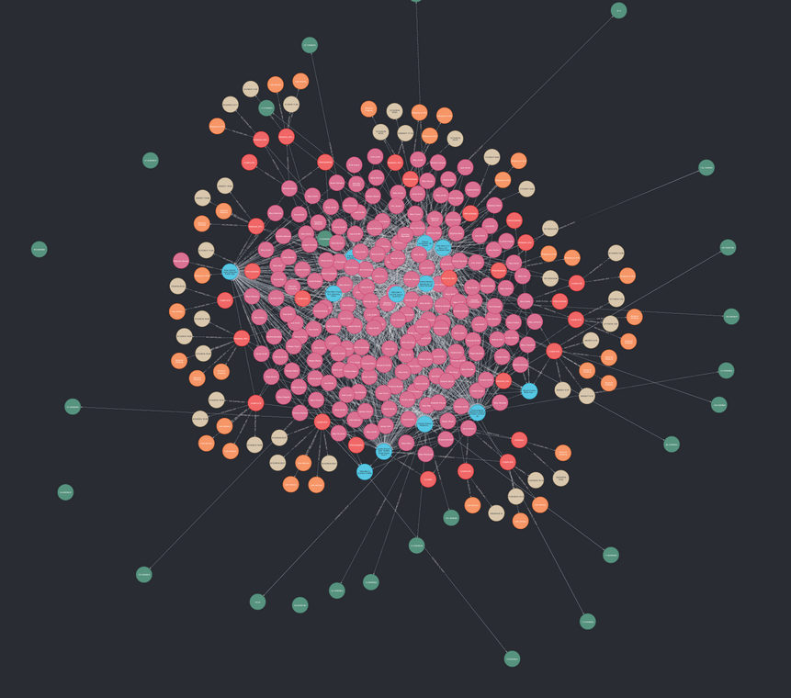

NEO4J
In Neo4j, the data loading process involved creating seven distinct labels and corresponding relationships to interconnect these labels.
Each label was assigned specific properties, forming a structured graph database schema tailored to the project's requirements.

Slide 9

2. Query Design
1
2
3
4
5
6
UNIQUE CUSTOMER NAME COUNT
AVERAGE SHIPPING
DELAY
TOP CITY BY PROFIT
TOP 5 PRODUCTS WITH LATE DELIVERY
SALES AND PROFIT BY CUSTOMER SEGMENT
TOP 3 FREQUENTLY BOUGHT PRODUCT
Calculated the count of distinct customer names to assess the diversity of the customer base.
we calculated the average delay in shipping by comparing the actual shipping days against the scheduled ones, which offered insights into the efficiency of the delivery process.
Identified the city with the highest total profit per order, showcasing regional sales performance.
Listed the top five products most frequently involved in late deliveries, highlighting areas for logistics improvement.
Analyzed sales and average benefit per order by customer segments, providing insights into customer behavior and profitability.
Calculated the average shipping duration for the top three products based on order frequency, aiding in understanding delivery efficiency.

Slide 10
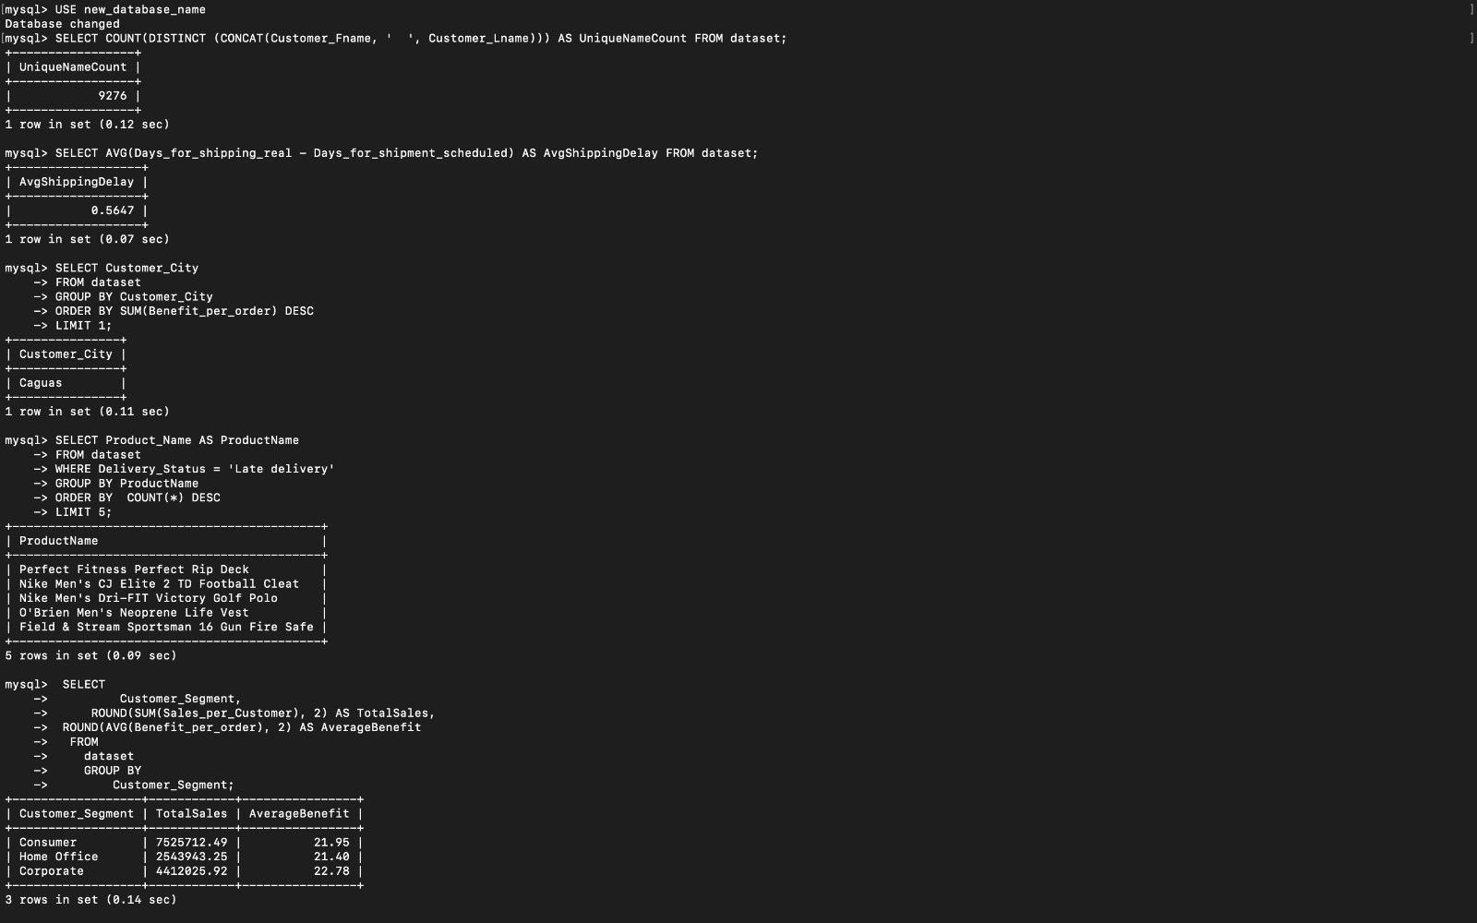
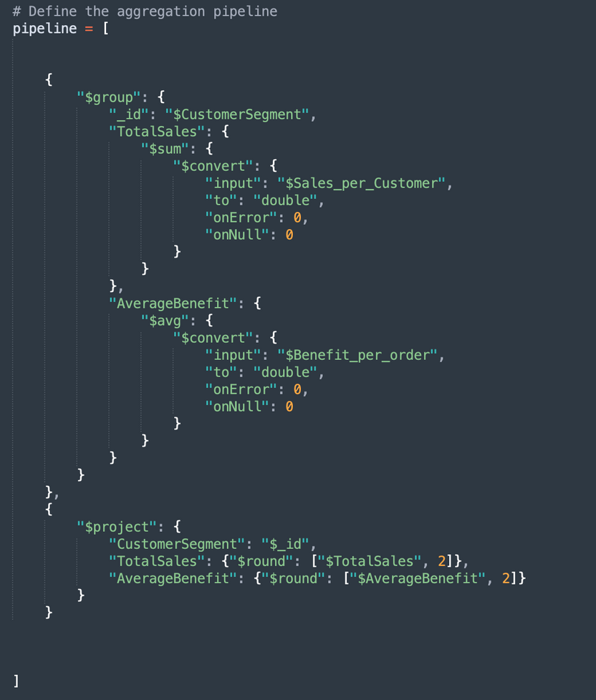
Queries in MONGODB- 6
Queries in MYSQL- ALL

Slide 11
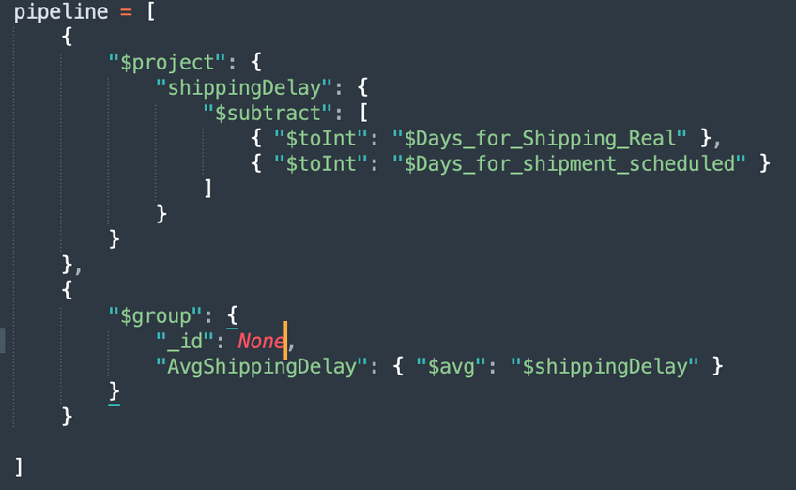
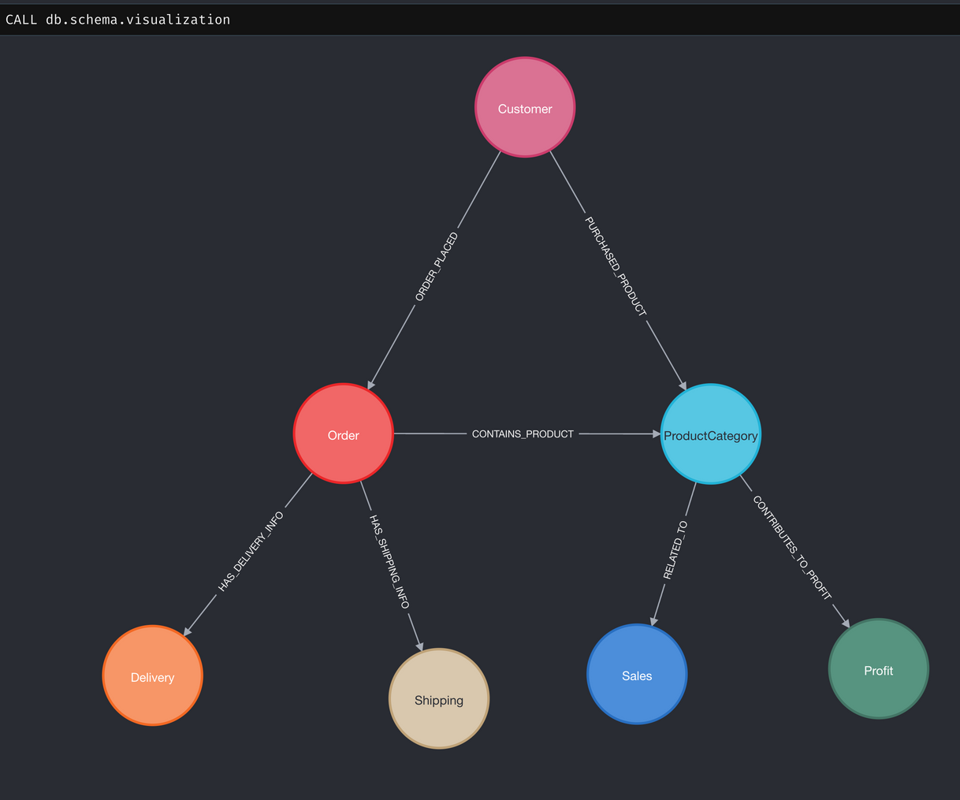
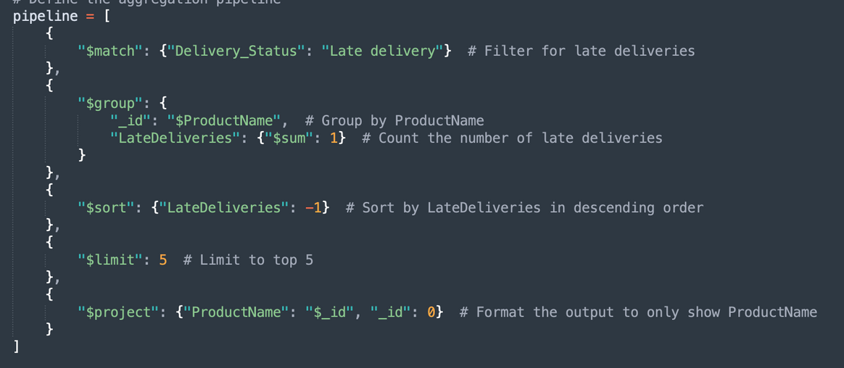
Queries in MONGODB-4 &5
NEO4J - :SCHEMA

Slide 12

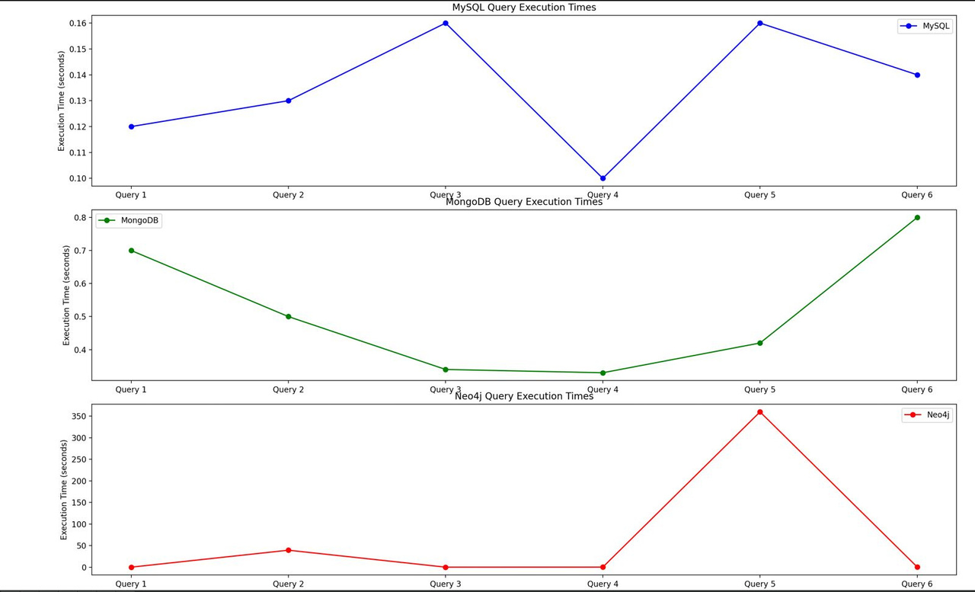
RESULTS
Execution Time Trends for MySQL, MongoDB, and Neo4j
Query execution trends vary significantly between databases; MySQL shows a peak at Query 4, MongoDB's times increase steadily, and Neo4j exhibits a spike at Query 5 followed by a sharp decrease.

Slide 13

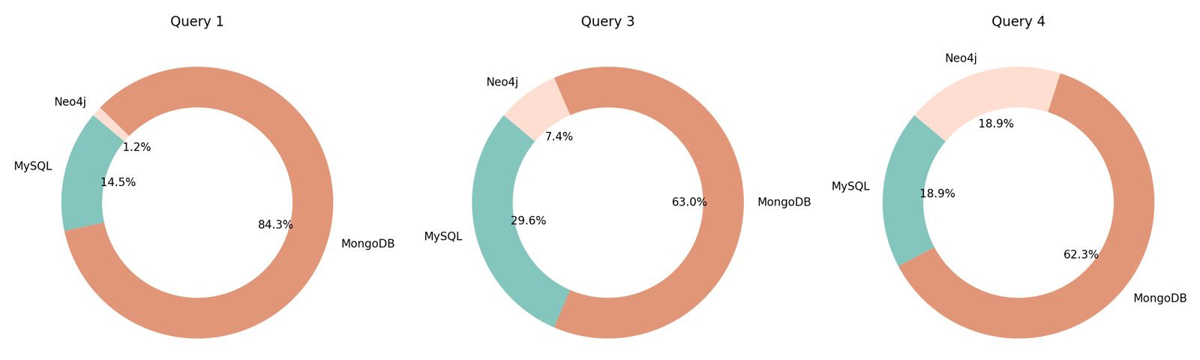
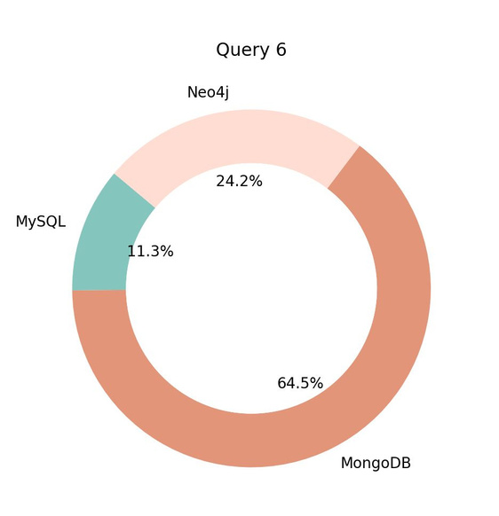
Database Query Performance Distribution
The data indicates that MongoDB consistently requires the longest execution times in comparison to MySQL and Neo4j

Slide 14

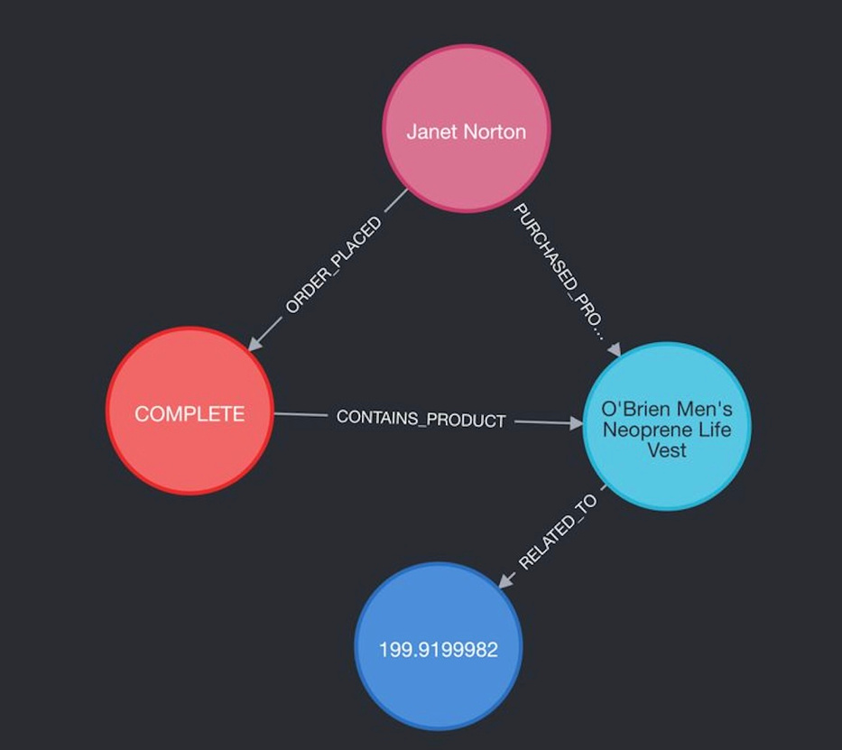
Customer Purchase Path Visualization in Neo4j
MATCH path = (customer:Customer)-[:ORDER_PLACED]->(order:Order)-[:CONTAINS_PRODUCT]->(p:ProductCategory)-[:RELATED_TO]->(s:Sales)
The image shows a customer's buying process in Neo4j, from order to sale, revealing how different parts of the sale are connected.

Slide 15
CONCLUSION
MySQL is optimal for structured queries like calculating average shipping delays or total sales, due to its relational data management.
MongoDB is suited for queries managing nested product attributes, taking advantage of its schema-less document format.
Neo4j is unmatched for queries that require traversing complex relationships, such as finding the shortest path between suppliers and products in the supply chain.

Slide 16

THANK YOU

